Slide 1
UPPER SIXTH ARTS
GEOGRAPHY
Lesson 1: Settlement: Meaning, Evolution and Early Location
Settlement: Meaning, Evolution and Early Location
Notes:
Good morning, class, and welcome to our geography lesson. I am your geography teacher, Mr Kamdem. Today we are starting Lesson 1: Settlement: Meaning, Evolution and Early Location.

Slide 2
CLASS INFO
Class, Chapter and Duration
Class | Upper Sixth Arts
Chapter | Module 5: Understanding and managing settlement dynamics across the world in general and Cameroon in particular
Duration | 2 periods (2 × 50 minutes)
Notes:
This lesson is for Upper Sixth Arts. It belongs to Module 5: Understanding and managing settlement dynamics across the world in general and Cameroon in particular. We shall need 2 periods to cover it.

Slide 3
IDENTIFICATION
Lesson Identification
Topic | Location of Settlement
Sub-topic | Location of Settlement
Lesson | Lesson 1: Settlement: Meaning, Evolution and Early Location
Notions / Concepts | Settlement, permanent settlement, temporary settlement, evolution, location factors.
Syllabus focus | Meaning of settlement; evolution of settlement; factors of the location of early settlements (resources, relief, drainage, routes, defence).
Competence | Learners are able to explain how settlements began and why early settlements were located where they are.
Notes:
Our topic is Location of Settlement, and the sub-topic is Location of Settlement. The key notions we shall use today are: settlement, permanent settlement, temporary settlement, evolution, location factors. At the end, you should be able to do this: learners are able to explain how settlements began and why early settlements were located where they are.

Slide 4

HOMEWORK CORRECTION
Correction of the Homework
Question (Further Study 1: Population Change in Cameroon):
Draw a map of Cameroon showing dense and sparse regions and the main migration flows.
Notes:
Before we start the new lesson, let us correct the homework I gave you at the end of Further Study 1: Population Change in Cameroon. The question was: Draw a map of Cameroon showing dense and sparse regions and the main migration flows. Take out your exercise books.

Slide 5
HOMEWORK CORRECTION
Correction: Possible Answer
The map shows dense regions (Littoral, West, North-West, Far North) and sparse regions (East, South, Adamawa), with arrows from the West, North and villages to Douala and Yaoundé.
Notes:
Here is a good answer. The map shows dense regions (Littoral, West, North-West, Far North) and sparse regions (East, South, Adamawa), with arrows from the West, North and villages to Douala and Yaoundé. Compare it with your own answer and correct your work in red.

Slide 6
LESSON PLAN
Lesson Plan
Correction of the homework
Objectives and recall
Real-life situation and action to take
Learning activities
Board summary
Evaluation, remediation and homework
Notes:
Here is the plan of our lesson today. First, we shall correct the homework. Then we shall look at the objectives and recall what you already know. After that, we shall study a situation from real life and the action to take, and do the learning activities. Finally, we shall copy the board summary, do the evaluation and the remediation, and I will give you the homework.

Slide 7
OBJECTIVES
Objectives
By the end of this lesson, you should be able to:
Define settlement and its types.
Describe the evolution of settlements.
Explain the factors of the location of early settlements.
Notes:
By the end of this lesson, you should be able to do three things. Number 1: define settlement and its types. Number 2: describe the evolution of settlements. Number 3: explain the factors of the location of early settlements.

Slide 8
PREVIOUS KNOWLEDGE
Previous Knowledge
People need water, food and shelter.
Population is unevenly distributed.
Notes:
Let us first remember what you already know. People need water, food and shelter. Population is unevenly distributed. Keep this in mind, because we shall build on it today.

Slide 9
REAL-LIFE SITUATION
Situation in Real Life
Many old villages in the Mandara Mountains are built on hills with springs nearby, while fishing villages sit on the shores of Lake Chad. Learners ask how early people chose where to live.
Notes:
Listen carefully to this situation from real life. Many old villages in the Mandara Mountains are built on hills with springs nearby, while fishing villages sit on the shores of Lake Chad. Learners ask how early people chose where to live. Think about it, because I am going to ask you some questions.

Slide 10
REAL-LIFE SITUATION
Situation: Question 1
What is the problem in the situation?
Notes:
Question 1: What is the problem in the situation? Think for a moment, then raise your hand to answer.

Slide 11
REAL-LIFE SITUATION
Answer
Learners want to know why settlements are where they are.
Notes:
Good. Learners want to know why settlements are where they are.

Slide 12
REAL-LIFE SITUATION
Situation: Question 2
Why were villages built on hills?
Notes:
Question 2: Why were villages built on hills? Think for a moment, then raise your hand to answer.

Slide 13
REAL-LIFE SITUATION
Answer
For defence and safety.
Notes:
Good. For defence and safety.

Slide 14
REAL-LIFE SITUATION
Situation: Question 3
Why near springs and lakes?
Notes:
Question 3: Why near springs and lakes? Think for a moment, then raise your hand to answer.

Slide 15
REAL-LIFE SITUATION
Possible Answer
For water and food.
Notes:
Good. For water and food.

Slide 16
ACTION TO TAKE
Action to Take
Understand why settlements were founded where they are, to plan new ones wisely.
Notes:
From this situation, the action we are working towards in this lesson is the following: understand why settlements were founded where they are, to plan new ones wisely.

Slide 17
JUSTIFICATION
Justification of the Lesson
This lesson helps us to understand the origin of the villages and towns we live in.
Notes:
Why is this lesson important for you? This lesson helps us to understand the origin of the villages and towns we live in.

Slide 18

1. MEANING OF SETTLEMENT
Activity 1
A village built into a hillside (Mandara region).
Notes:
Activity 1. Look carefully at this picture: a village built into a hillside (Mandara region). Observe every detail before I ask the question.

Slide 19
1. MEANING OF SETTLEMENT
Activity 1: Question
What is a settlement?
Notes:
Here is the question for Activity 1: What is a settlement? Take one minute to think and write your answer in your rough notebook.

Slide 20
1. MEANING OF SETTLEMENT
Activity 1: Answer
A place where people live, from one house to a big city.
Notes:
Let us check the answer together. A place where people live, from one house to a big city.

Slide 21

1. MEANING OF SETTLEMENT
Activity 2
A nomad tent in the Sahara (Morocco).
Notes:
Activity 2. Look carefully at this picture: a nomad tent in the Sahara (Morocco). Observe every detail before I ask the question.

Slide 22
1. MEANING OF SETTLEMENT
Activity 2: Question
Is a nomad camp a permanent or a temporary settlement?
Notes:
Here is the question for Activity 2: Is a nomad camp a permanent or a temporary settlement? Take one minute to think and write your answer in your rough notebook.

Slide 23
1. MEANING OF SETTLEMENT
Activity 2: Answer
Temporary: nomads move with their animals.
Notes:
Let us check the answer together. Temporary: nomads move with their animals.

Slide 24
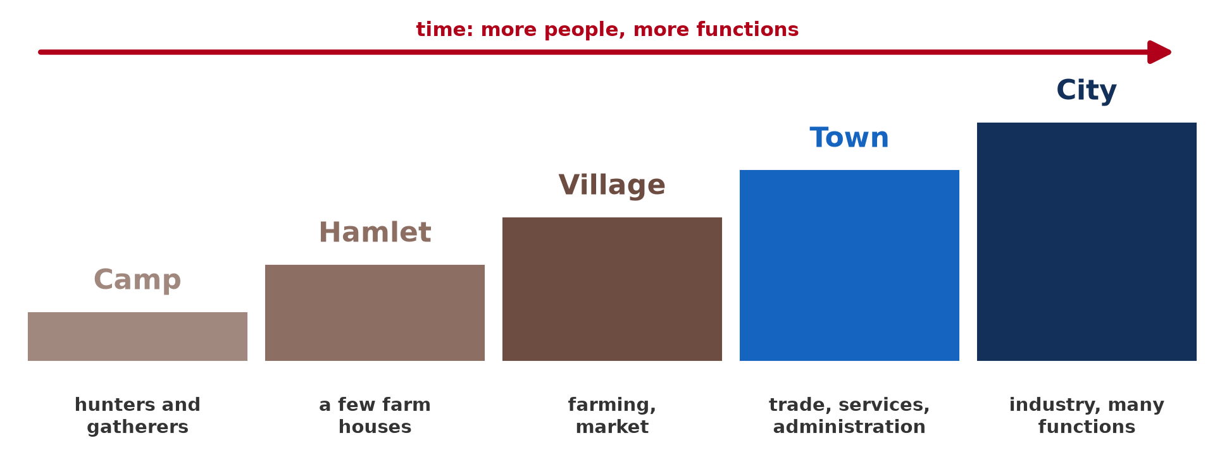
2. EVOLUTION OF SETTLEMENT
Activity 3
From camp to city.
Notes:
Activity 3. Look carefully at this diagram: from camp to city. Observe every detail before I ask the question.

Slide 25
2. EVOLUTION OF SETTLEMENT
Activity 3: Question
Put these in order: town, hamlet, city, village.
Notes:
Here is the question for Activity 3: Put these in order: town, hamlet, city, village. Take one minute to think and write your answer in your rough notebook.

Slide 26
2. EVOLUTION OF SETTLEMENT
Activity 3: Answer
Hamlet, village, town, city.
Notes:
Let us check the answer together. Hamlet, village, town, city.

Slide 27
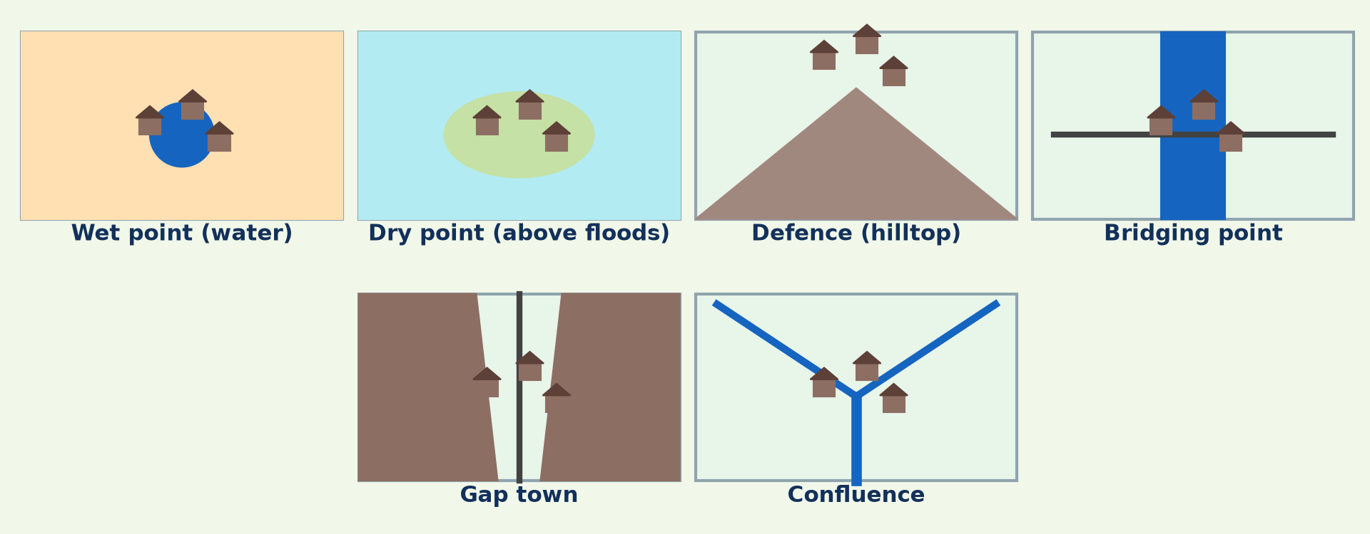
3. FACTORS OF EARLY LOCATION
Activity 4
Types of settlement site.
Notes:
Activity 4. Look carefully at this diagram: types of settlement site. Observe every detail before I ask the question.

Slide 28
3. FACTORS OF EARLY LOCATION
Activity 4: Question
Give three factors of the location of early settlements.
Notes:
Here is the question for Activity 4: Give three factors of the location of early settlements. Take one minute to think and write your answer in your rough notebook.

Slide 29
3. FACTORS OF EARLY LOCATION
Activity 4: Answer
Water supply, defence and dry, fertile land (also routes, resources).
Notes:
Let us check the answer together. Water supply, defence and dry, fertile land (also routes, resources).

Slide 30

3. FACTORS OF EARLY LOCATION
Activity 5
A village on stilts over water (Brunei).
Notes:
Activity 5. Look carefully at this picture: a village on stilts over water (Brunei). Observe every detail before I ask the question.

Slide 31
3. FACTORS OF EARLY LOCATION
Activity 5: Question
Why did some people build on water?
Notes:
Here is the question for Activity 5: Why did some people build on water? Take one minute to think and write your answer in your rough notebook.

Slide 32
3. FACTORS OF EARLY LOCATION
Activity 5: Answer
For fishing, trade by boat and protection.
Notes:
Let us check the answer together. For fishing, trade by boat and protection.

Slide 33
BOARD SUMMARY
Board Summary
Topic: Location of Settlement
Sub-topic: Location of Settlement
Lesson 1: Settlement: Meaning, Evolution and Early Location
Notes:
Now we are going to copy the board summary. Write the title and the headings neatly in your notebooks. I will give you enough time for each slide, so do not rush.

Slide 34
BOARD SUMMARY
1. Meaning of Settlement
A settlement can be understood as follows:
Settlement: It is a place where people live, with houses and the activities linked to them, from a single hut to a large city.
Notes:
Let us copy Meaning of Settlement. A settlement can be understood as follows. On this slide we have Settlement. Write each point on a new line, with the key term first, and explain it in your own words when we revise. When you finish, we go to the next slide.

Slide 35
BOARD SUMMARY
1. Meaning of Settlement (continued)
Permanent and temporary settlements: Permanent settlements are occupied all year, like villages and towns. Temporary ones are used for a season, like nomad camps and fishing camps.
Notes:
We continue with Meaning of Settlement. On this slide we have Permanent and temporary settlements. Write each point on a new line, with the key term first, and explain it in your own words when we revise.

Slide 36
BOARD SUMMARY
2. Evolution of Settlement
Settlements evolved as follows:
Early settlements: Hunters and gatherers lived in temporary camps. The development of farming about 10,000 years ago led to permanent villages.
Notes:
Let us copy Evolution of Settlement. Settlements evolved as follows. On this slide we have Early settlements. Write each point on a new line, with the key term first, and explain it in your own words when we revise. When you finish, we go to the next slide.

Slide 37
BOARD SUMMARY
2. Evolution of Settlement (continued)
Growth into towns and cities: Surplus food, trade and crafts allowed villages to grow into towns. The Industrial Revolution made cities grow very fast.
Notes:
We continue with Evolution of Settlement. On this slide we have Growth into towns and cities. Write each point on a new line, with the key term first, and explain it in your own words when we revise.

Slide 38
BOARD SUMMARY
2. Evolution of Settlement
Illustration: from hamlet to city
Notes:
Now draw this illustration in your notebook: from hamlet to city. Give it a title and label it clearly.

Slide 39
BOARD SUMMARY
3. Factors Affecting the Location of Early Settlements
Early settlements were located according to:
Water supply and drainage: People settled near springs, rivers and wells, but above flood level. Wet-point sites were common in dry areas.
Notes:
Let us copy Factors Affecting the Location of Early Settlements. Early settlements were located according to. On this slide we have Water supply and drainage. Write each point on a new line, with the key term first, and explain it in your own words when we revise. When you finish, we go to the next slide.

Slide 40
BOARD SUMMARY
3. Factors Affecting the Location of Early Settlements (continued)
Resources and relief: Fertile soils, forests, fish and minerals attracted people. Gentle slopes and flat land were easier to build on.
Notes:
We continue with Factors Affecting the Location of Early Settlements. On this slide we have Resources and relief. Write each point on a new line, with the key term first, and explain it in your own words when we revise. When you finish, we go to the next slide.

Slide 41
BOARD SUMMARY
3. Factors Affecting the Location of Early Settlements (continued)
Defence and routes: Hill tops, river bends and islands were easy to defend. Route junctions, fords and bridging points favoured trade.
Notes:
We continue with Factors Affecting the Location of Early Settlements. On this slide we have Defence and routes. Write each point on a new line, with the key term first, and explain it in your own words when we revise.

Slide 42
BOARD SUMMARY
3. Factors Affecting the Location of Early Settlements
Illustration: types of early settlement sites
Notes:
Now draw this illustration in your notebook: types of early settlement sites. Give it a title and label it clearly.

Slide 43
FORMATIVE EVALUATION
Evaluation 1
Distinguish permanent and temporary settlements.
Notes:
Now let us check what you have understood. Question 1: Distinguish permanent and temporary settlements. Answer in your exercise book.

Slide 44
FORMATIVE EVALUATION
Expected Answer
Permanent settlements are lived in all year; temporary ones only for a short time.
Notes:
The expected answer is: permanent settlements are lived in all year; temporary ones only for a short time. If you got it right, well done.

Slide 45
FORMATIVE EVALUATION
Evaluation 2
Give three factors of the location of early settlements.
Notes:
Now let us check what you have understood. Question 2: Give three factors of the location of early settlements. Answer in your exercise book.

Slide 46
FORMATIVE EVALUATION
Expected Answer
Water, defence and fertile land (also routes, resources).
Notes:
The expected answer is: water, defence and fertile land (also routes, resources). If you got it right, well done.

Slide 47
REMEDIATION
Remediation
Fill in the blanks:
A place where people live is a ______.
A nomad camp is a ______ settlement.
Hilltop sites were chosen for ______.
Notes:
For those who need more practice, fill in the blanks in your exercise book. The answers are: number 1, settlement; number 2, temporary; number 3, defence.

Slide 48
HOMEWORK
Homework
Ask an old person why your village was founded where it is.
Notes:
For your homework: Ask an old person why your village was founded where it is. We shall correct it at the beginning of our next lesson.

Slide 49
NEXT LESSON
Next Lesson
Our next lesson will be on:
Lesson 2: Site and Situation of Settlements
Notes:
Our next lesson will be on Lesson 2: Site and Situation of Settlements. Thank you for your attention, and see you next time.

Slide 50
BILINGUAL GAME
Bilingual Game (Jeu Bilingue)
English | Français
Settlement | L'habitat, l'établissement humain
Village | Le village
Hamlet | Le hameau
Defence | La défense
Spring | La source
Nomad | Le nomade
Notes:
Let us play the bilingual game. I say a word in English, and you give me the French word. Then we do the reverse.

Slide 51
LOGBOOK
Official Logbook (1/2)
Module / Topic | Location of Settlement
Lesson Title | Lesson 1: Settlement: Meaning, Evolution and Early Location
Expected Learning Outcomes | Define settlement and its types. Describe the evolution of settlements. Explain the factors of the location of early settlements.
Competence | Learners are able to explain how settlements began and why early settlements were located where they are.
Notes:
I record this information in the official logbook of the class after the lesson.

Slide 52
LOGBOOK
Official Logbook (2/2)
Matter Taught | Meaning of Settlement; Evolution of Settlement; Factors Affecting the Location of Early Settlements.
Evaluation | Formative evaluation and remediation exercise.
Homework | Ask an old person why your village was founded where it is.
Enrolment / Present / Absent | ____ / ____ / ____
Achievement | To be completed after the lesson.
Notes:
I complete the second page of the logbook: the matter taught, the evaluation, the homework and the attendance.

Slide 53
TEACHER'S NOTE
Teacher's Note
Timing: Homework correction, plan, objectives 8 min | Recall, situation, action 10 min | 5 activities 30 min | Board summary (copying) 30 min | Evaluation, remediation 10 min | Homework, next lesson 5 min | Logbook 7 min
Without the projector (Activity 1): describe your home village.
Without the projector (Activity 2): compare with Mbororo camps.
Without the projector (Activity 3): draw the bars.
Without the projector (Activity 4): list the factors.
Without the projector (Activity 5): mention fishing camps on the coast.
Notes:
This slide is for me, the teacher: it gives the timing of the lesson and what to do if the projector is not available.

Slide 54
REFERENCES
References
National Geography Syllabus, MINESEC/IGE/IP-SS, 2019 — Module 5 (Settlement Geography).
Photo, Activity 1: “Village built into the hillside” by 10b travelling / Carsten ten Brink, CC BY-NC-ND 2.0, via Flickr (https://www.flickr.com/photos/77334245@N00/5677301357)
Photo, Activity 2: “A roadside stop for souvenirs & exploring dry wells, Northern Sahara, ” by ali eminov, CC BY-NC 2.0, via Flickr (https://www.flickr.com/photos/27435717@N00/3437516165)
Photo, Activity 5: “Village on the water Brunei.” by Bernard Spragg, CC0 1.0, via Flickr (https://www.flickr.com/photos/88123769@N02/15383937049)
Diagrams and animations: drawn for this lesson (Geography Department).
Notes:
These are the references and picture credits used to prepare this lesson.

